Slide 1
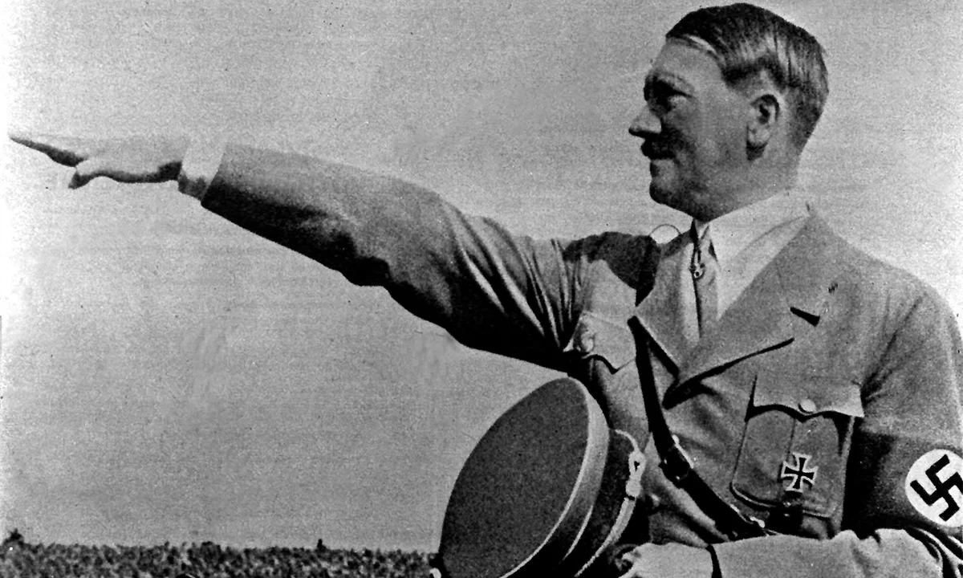
Hallo Zusammen

Slide 2

Encrypted Compression System

Slide 3

What is this Tool?
Notes:
A program that encrypts and compresses text files.
Decrypts and decompresses them back to their original state.

Slide 4
Why should we use this tool?
Notes:
Demonstrates the combination of simple encryption and compression techniques using advanced Quantum computing technology.
Highlights the utility of Caesar Cipher and Run-Length Encoding

Slide 5
Key Features
Login System
Encryption and Decryption
Compression and Decompression
User friendly Basic Interface
Notes:
Encryption:
Uses Caesar Cipher, a simple substitution cipher that shifts letters by a fixed number.
Compression:
Employs Run-Length Encoding (RLE), a lossless compression method.
User-Friendly Interface:
Login and registration system for personalized use.
Clear options for encryption, compression, decryption, and decompression.

Slide 6

How does this program works?

Slide 7
This Works by
User Login
File Encryption and compression
File Decryption and Decompression
Notes:
User Logs In:
Ensures personalized usage.
File Encryption and Compression:
Input a text file.
Encrypt and compress the content.
Save the processed file.
File Decryption and Decompression:
Input an encrypted and compressed file.
Decrypt and decompress the content.
Restore the original text.

Slide 8
Limitations
Caesar Cipher is not secure for sensitive data.
RLE is inefficient for files with non-repeating characters.
The tool is designed for learning purposes and not production use.

Slide 9
Future Improvements
Use advanced encryption algorithms like AES.
Implement more efficient compression techniques like Huffman Coding.
Add a graphical user interface (GUI) for ease of use.

Slide 10

Thanks Everyone.

